Slide 1

Programming for graphics
Where Next?

Slide 2
Congratulations!
You are days away from finishing the unit!

Slide 3
In this unit you have…
Learnt how computers draw 3D graphics
OpenGl
Shaders
Lighting techniques
Transforms
Matrices
Projection
Loading and Drawing 3D geometry
Loading textures

Slide 4
So what’s next?

Slide 5
The graphics pipe line
We only scratched the surface of how this work.
Tessellation shaders
Compute
Shaders
APIs (cuda, OpenCL)
Quaternions
Aliasing and antialiasing
Animation
Textures
Mesh
Morph targets
Skeletal
Mapping
Parallax
Textures lighting
Cube mapping
Shadows
Physically based shading
Local illumination
Global illumination
Depth of field
Motion blur
Sprites
Billboards
Voxels
Volumetric effects
Text
UI
Optimizations
Culling
Back face culling
frustrum
Occlusion
Portal
LOD
Ray Tracing

Slide 6
And that’s still not all!
But alas, we are out of time…

Slide 7
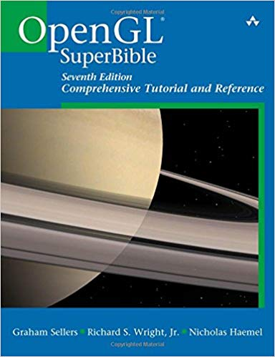
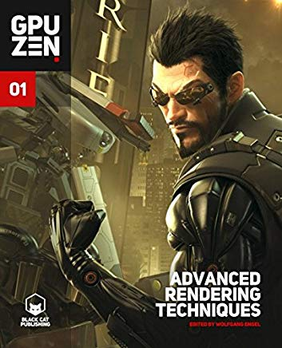
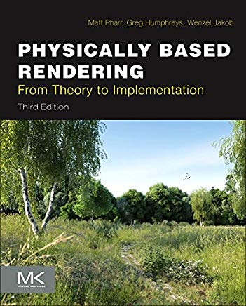
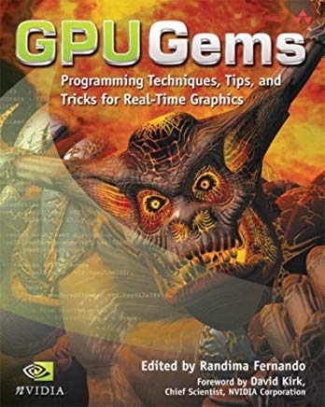
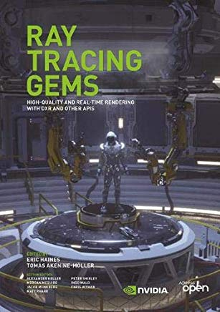
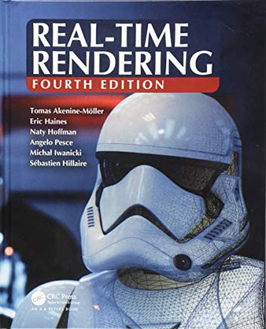
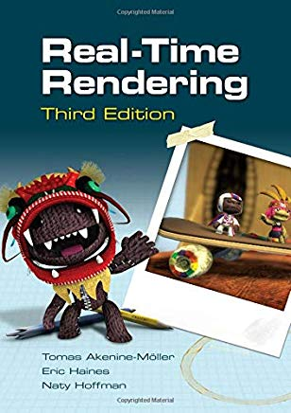
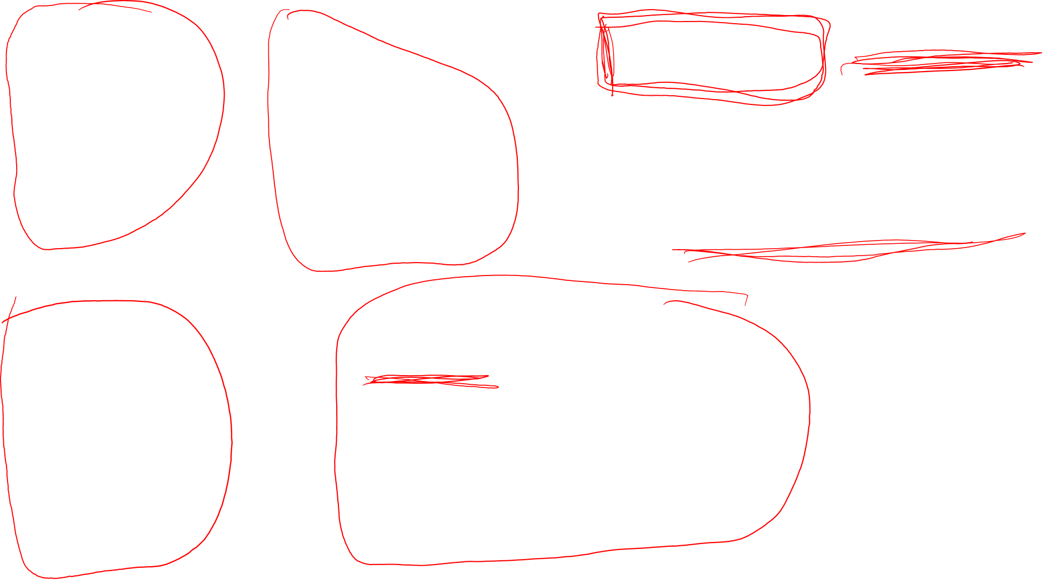
You can find these, for free, online

Slide 8
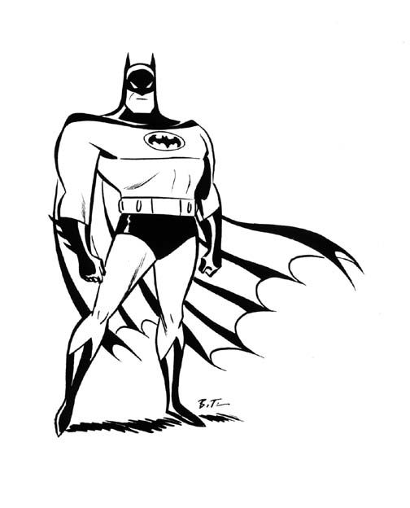

Slide 9


